Slide 1


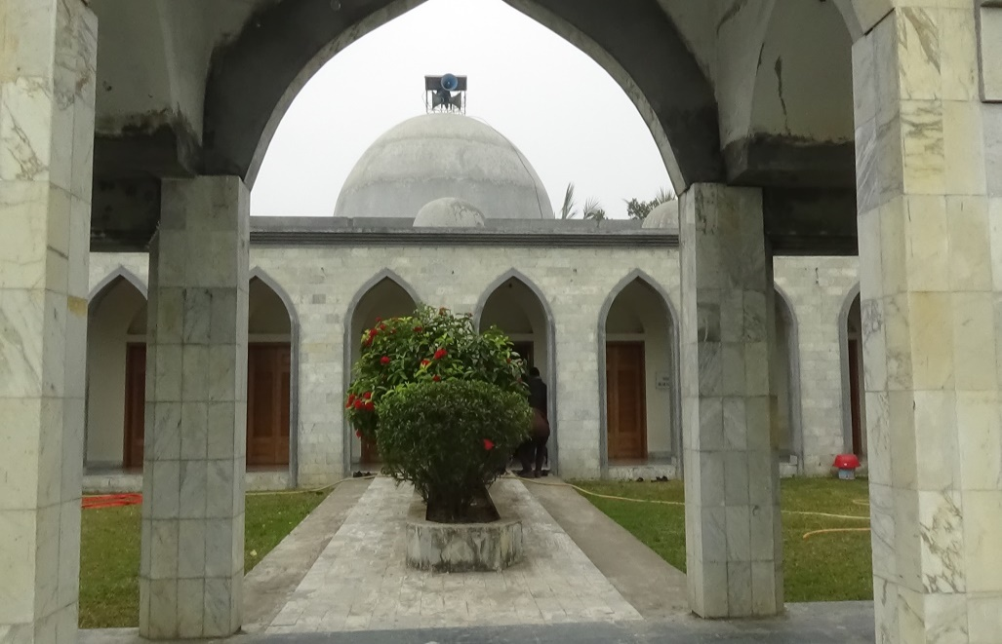
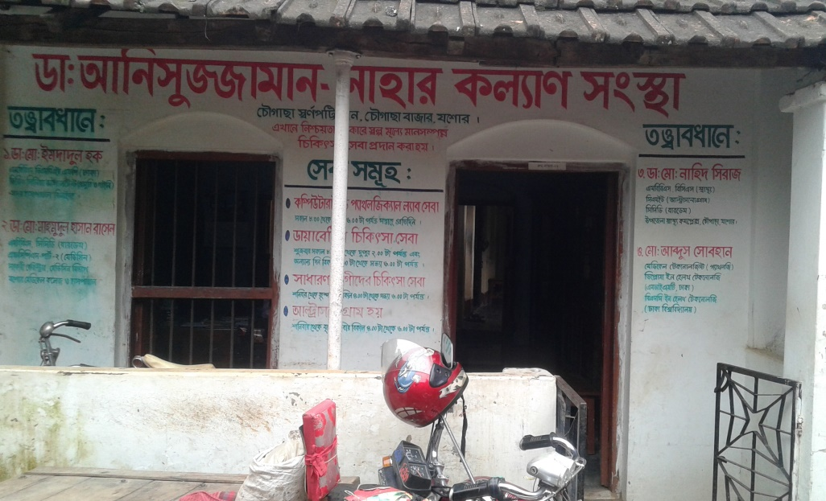
Development of Chowgacha Upazilla by Divine Group

Slide 2

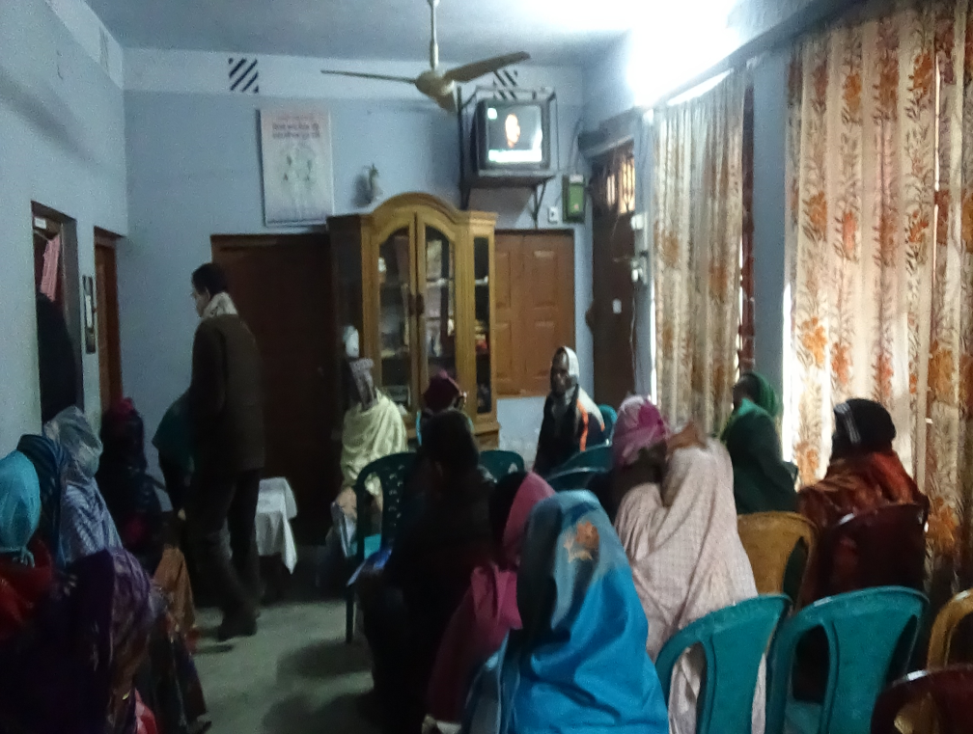
Dr. Anisuzzaman Nahar Kolyan Sangstha for poor and Diabetic patients.
Nearly 3 thousands Diabetic Patients is getting services from the centre.

Slide 3
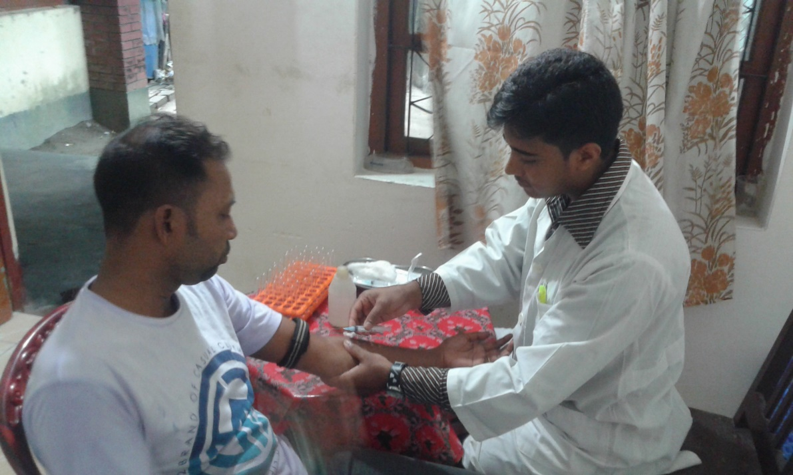
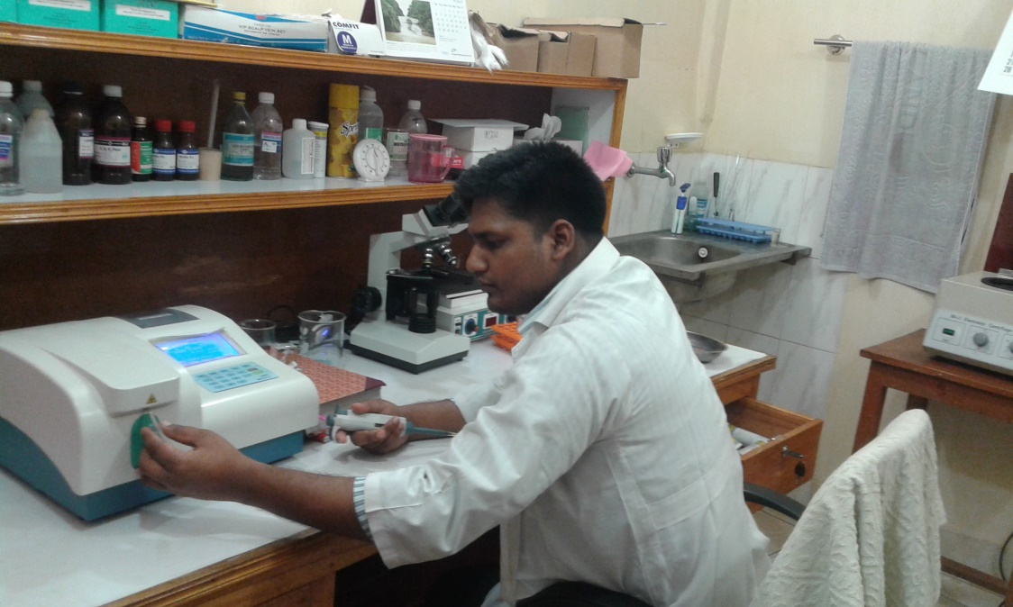
Blood sample collection
Laboratory investigation

Slide 4
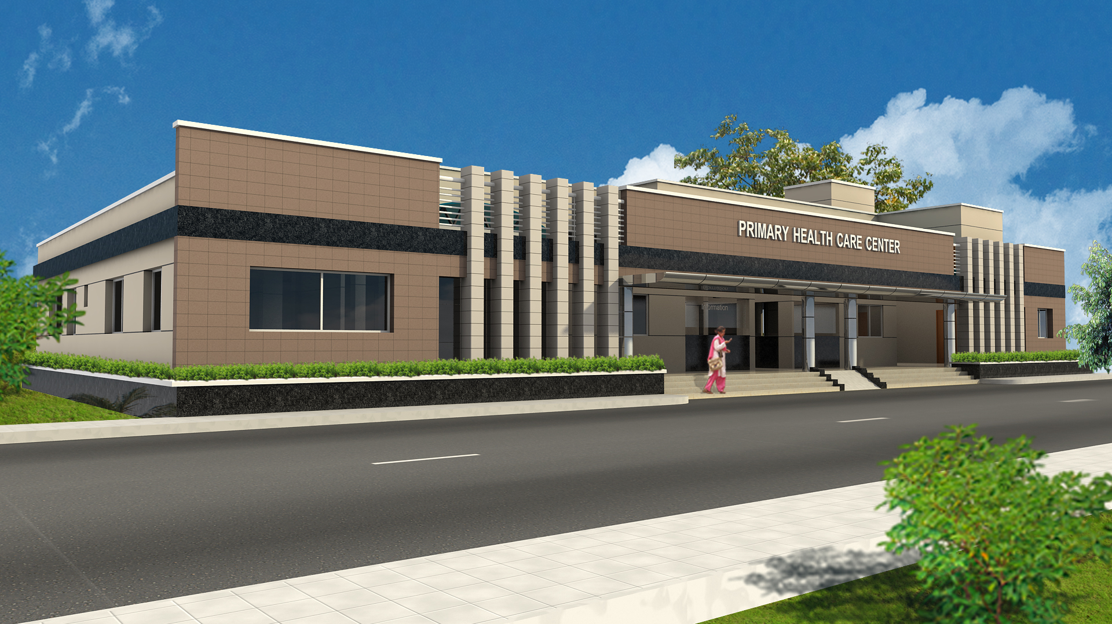
Architectural view of Chowgacha PHCC

Slide 5
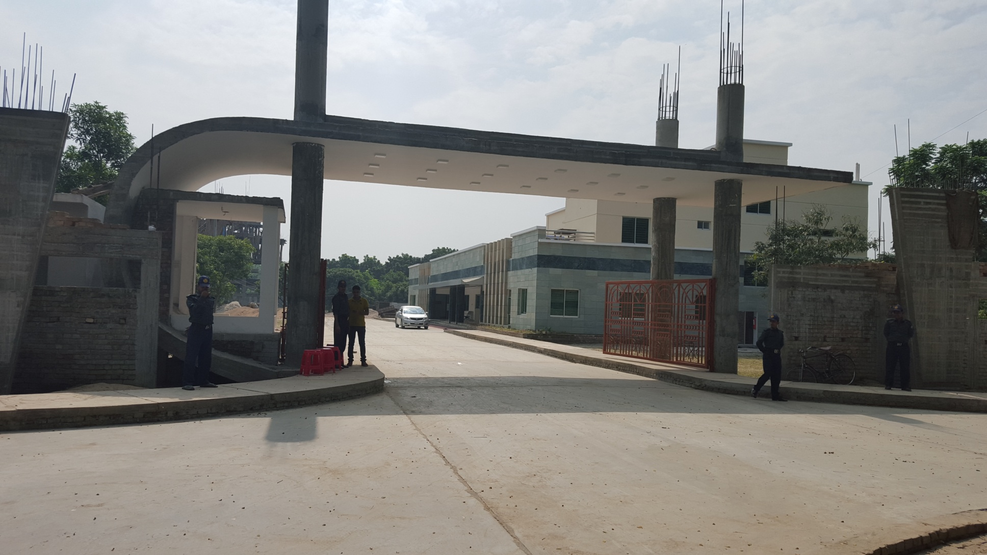
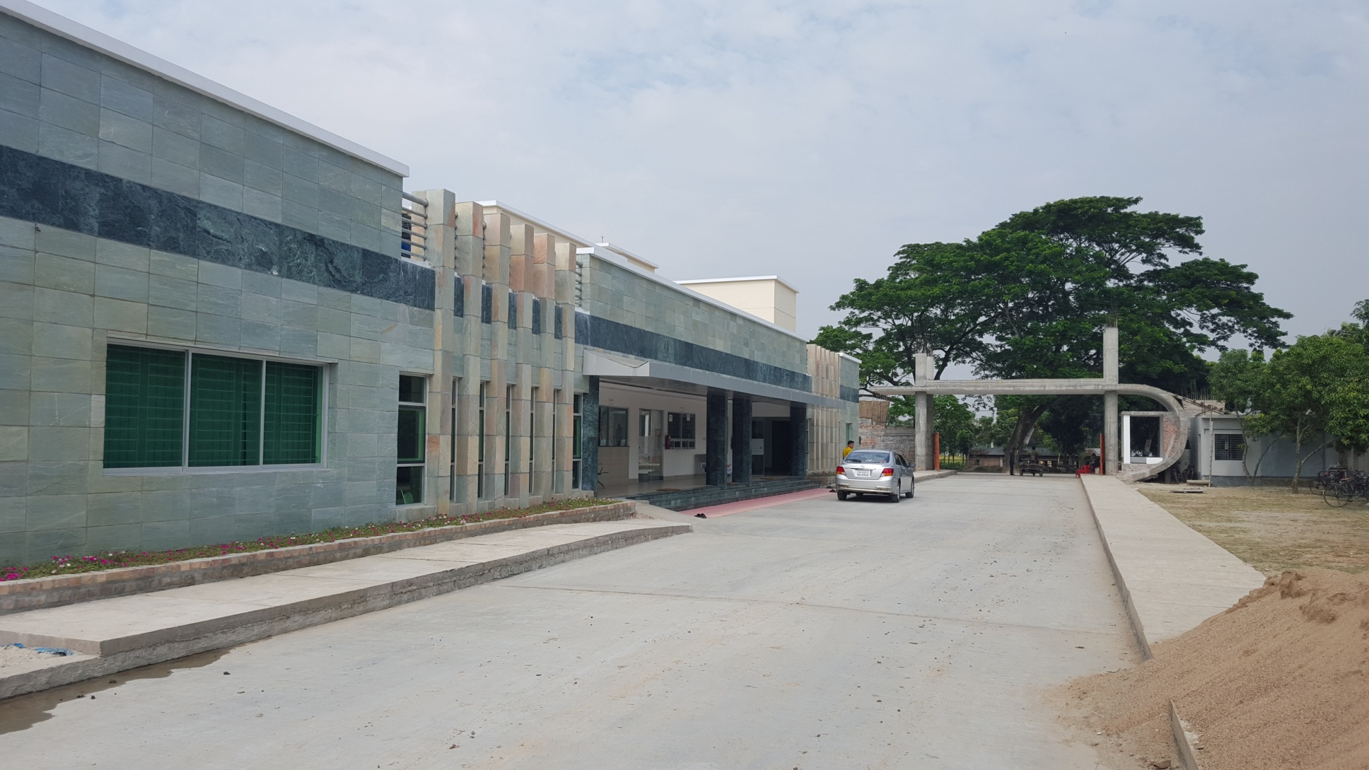
PHCC building
View from main gate

Slide 6
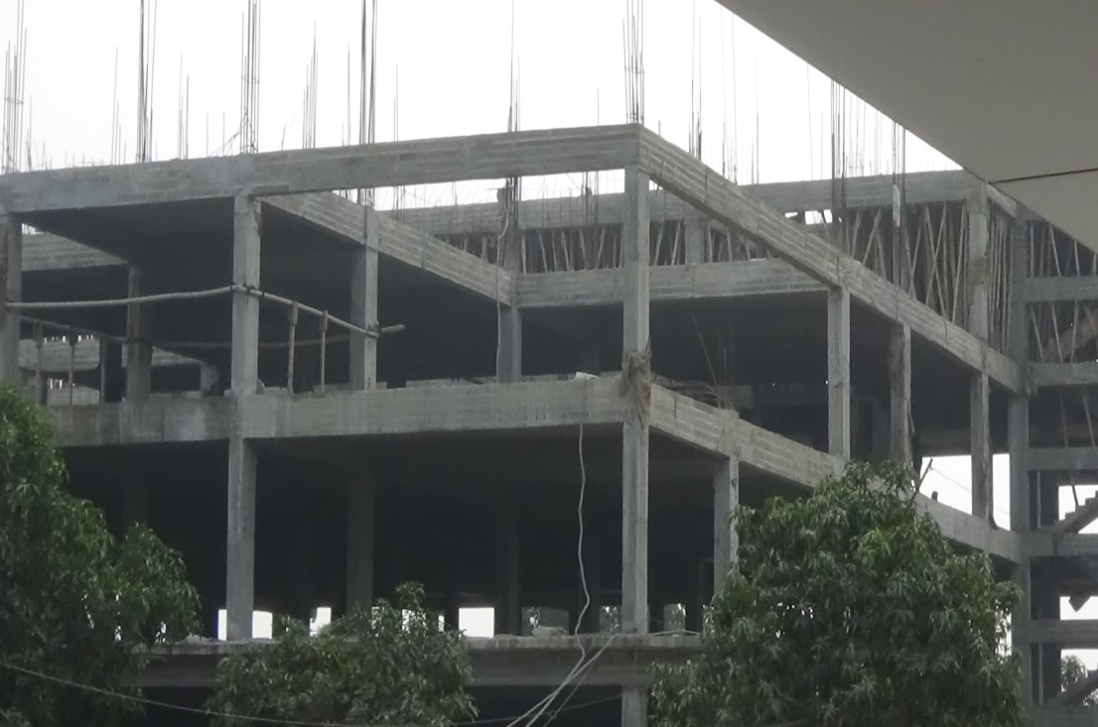
PHC Building front view
Secondary Hospital Under construction

Slide 7
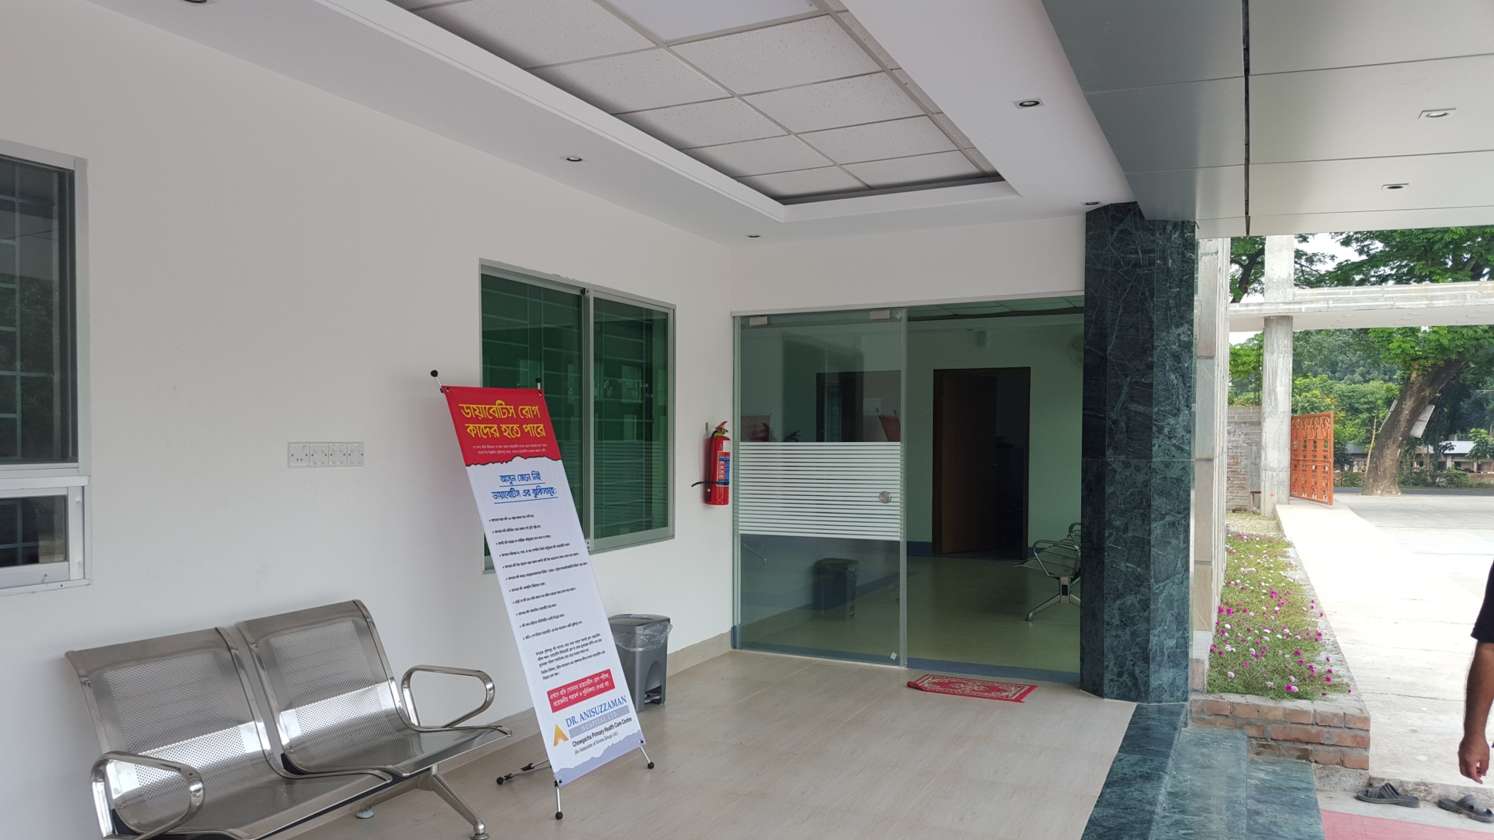
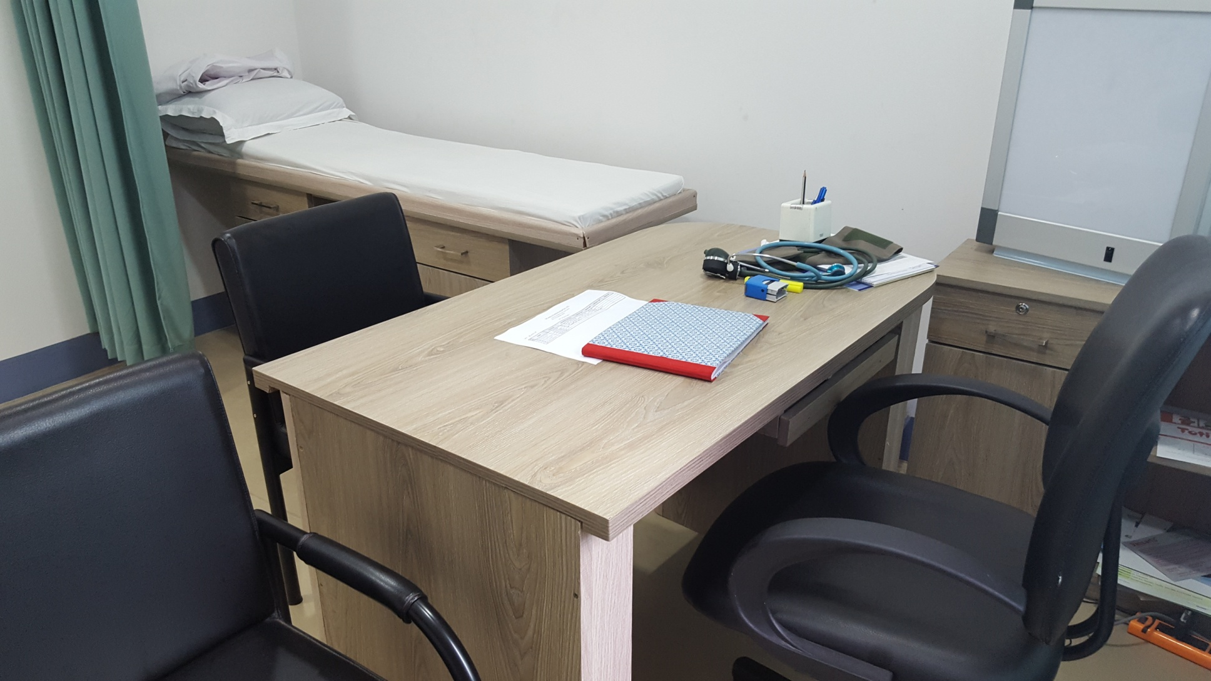
Entrance to service area of PHCC
Doctor’s room

Slide 8
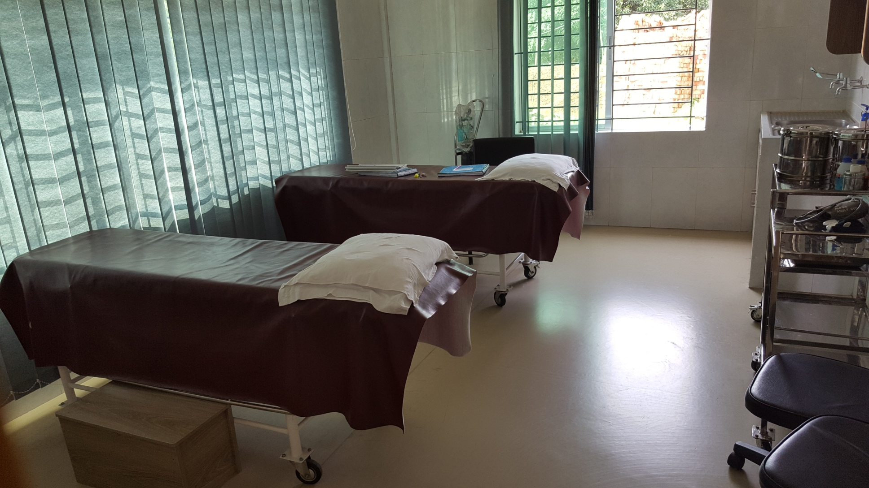
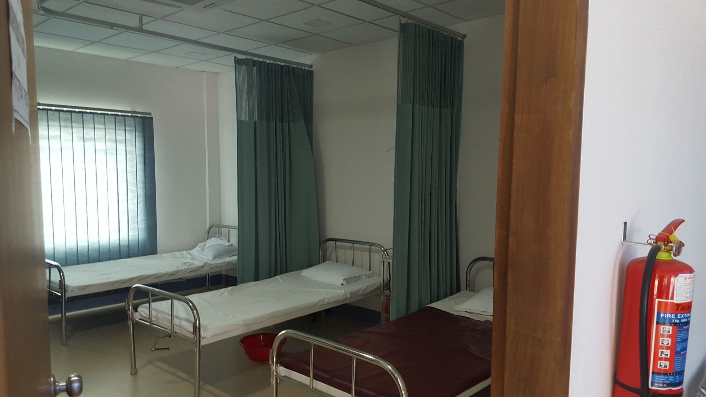
First Aid & Treatment room
Observation room

Slide 9
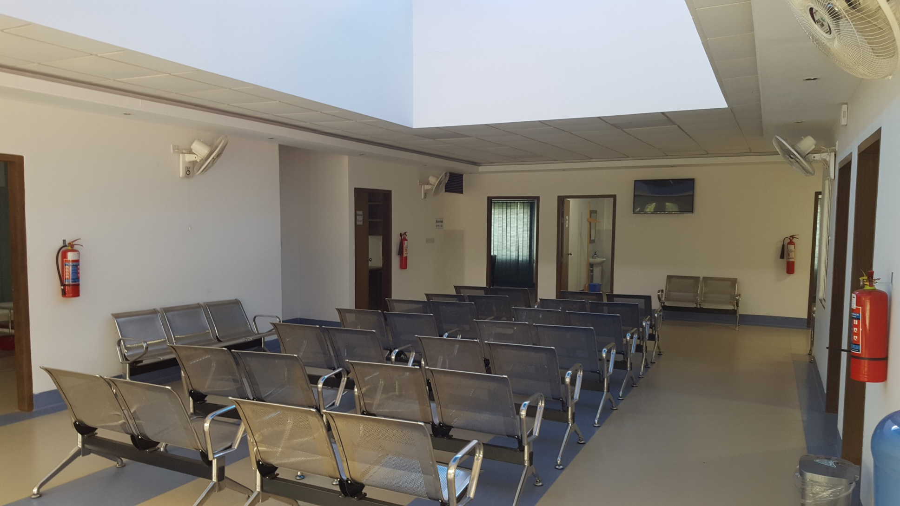
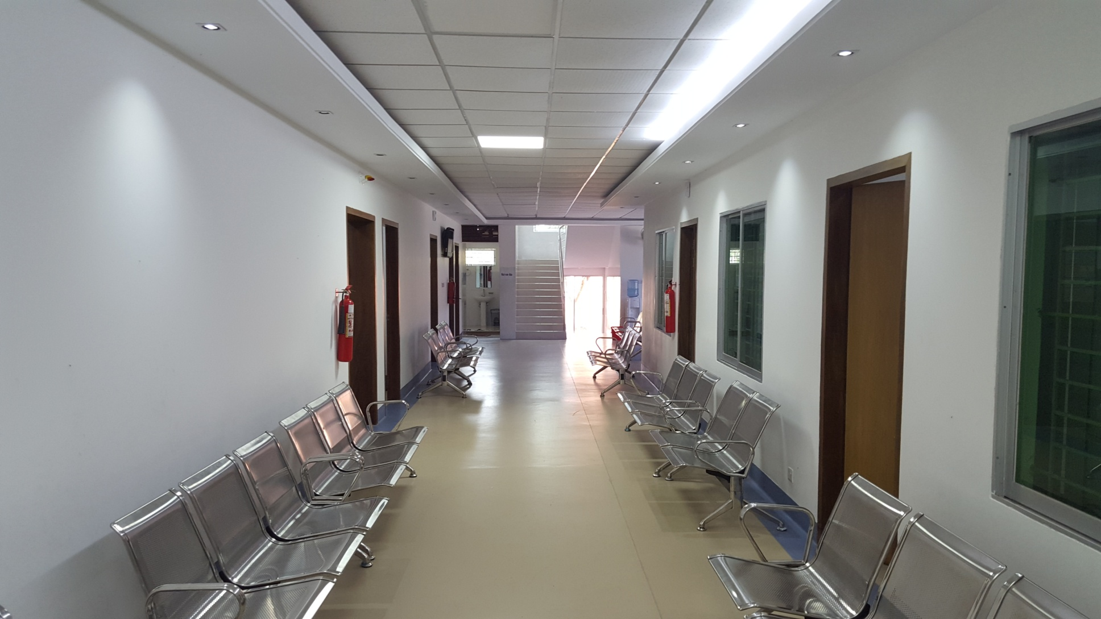
Waiting space for doctor’s clinic
Waiting space for Dental, Laboratory X-Ray & ECG

Slide 10
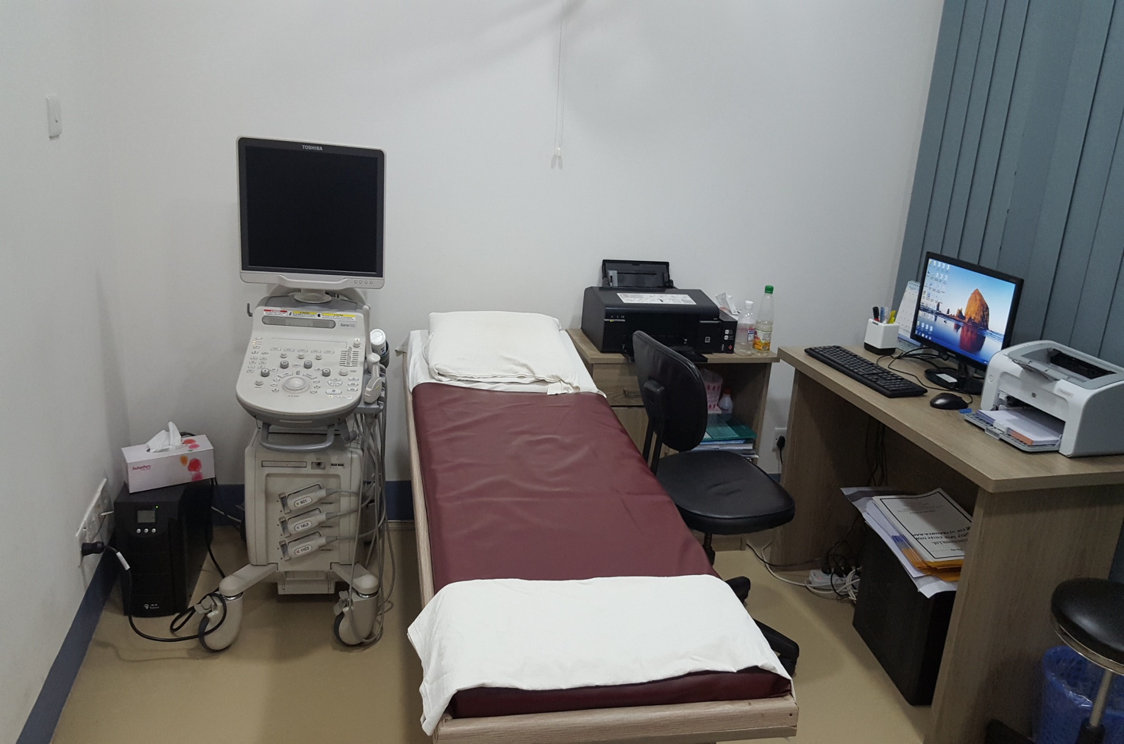
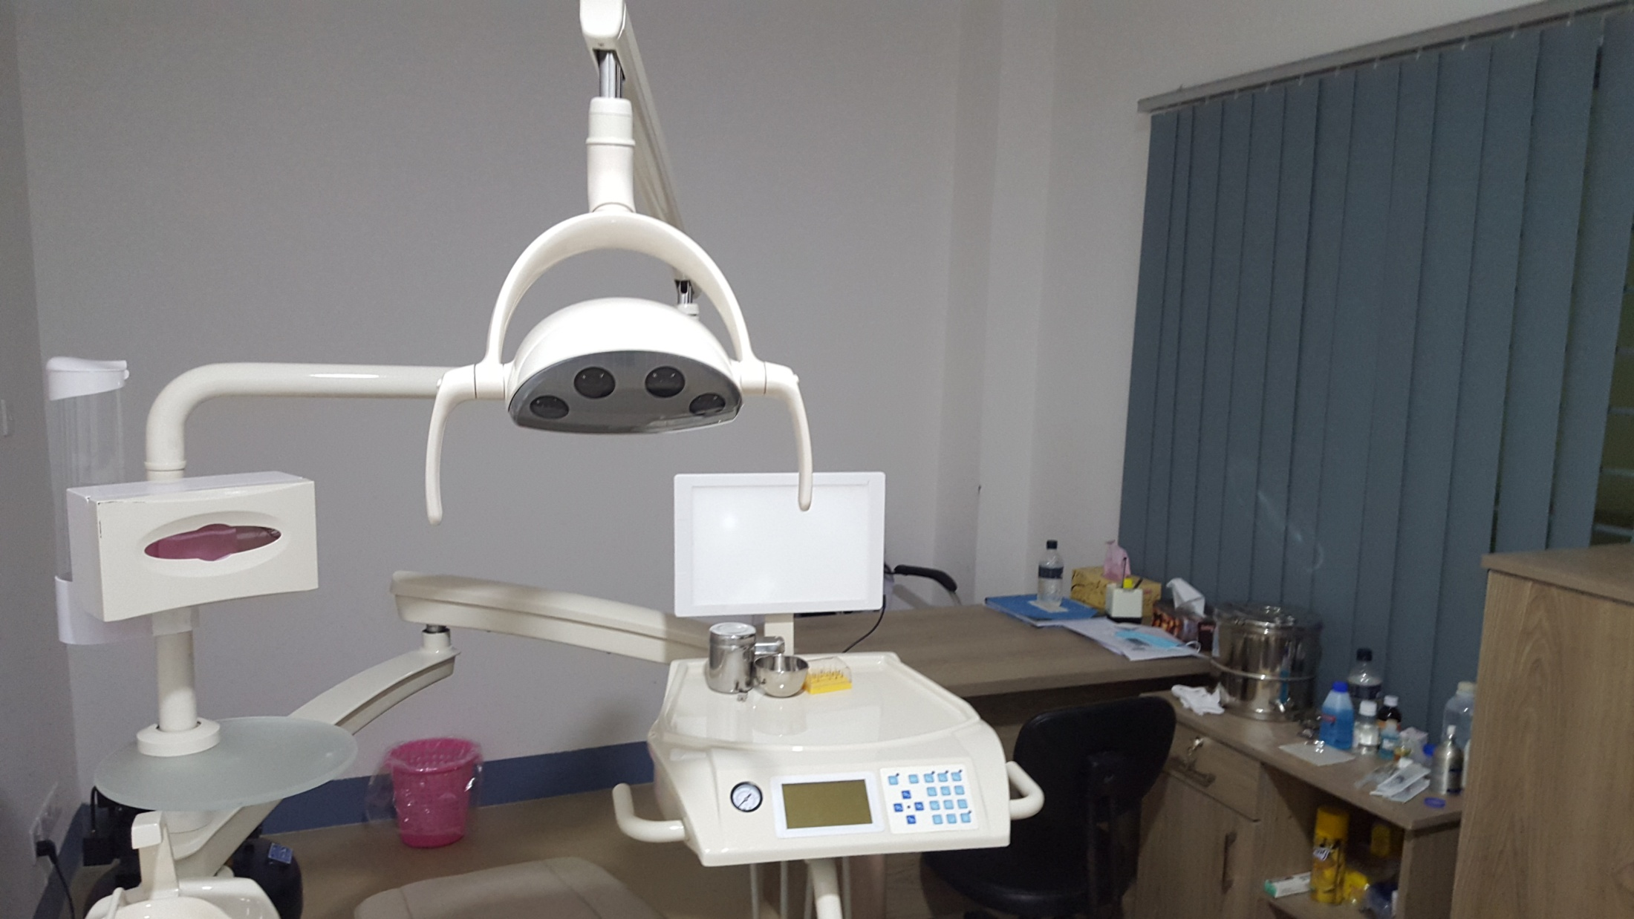
Ultra sonogram
Dental clinic

Slide 11
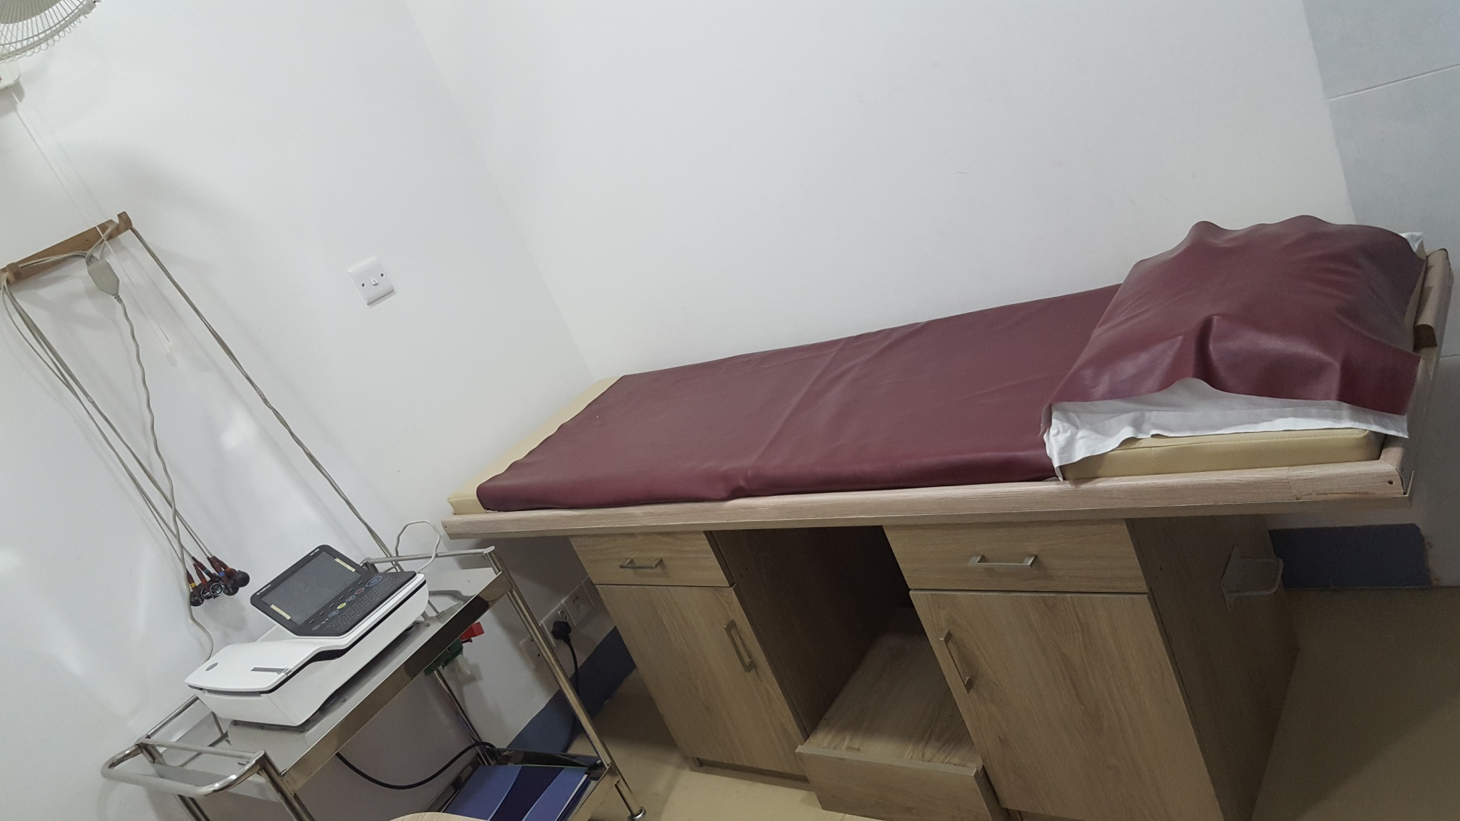
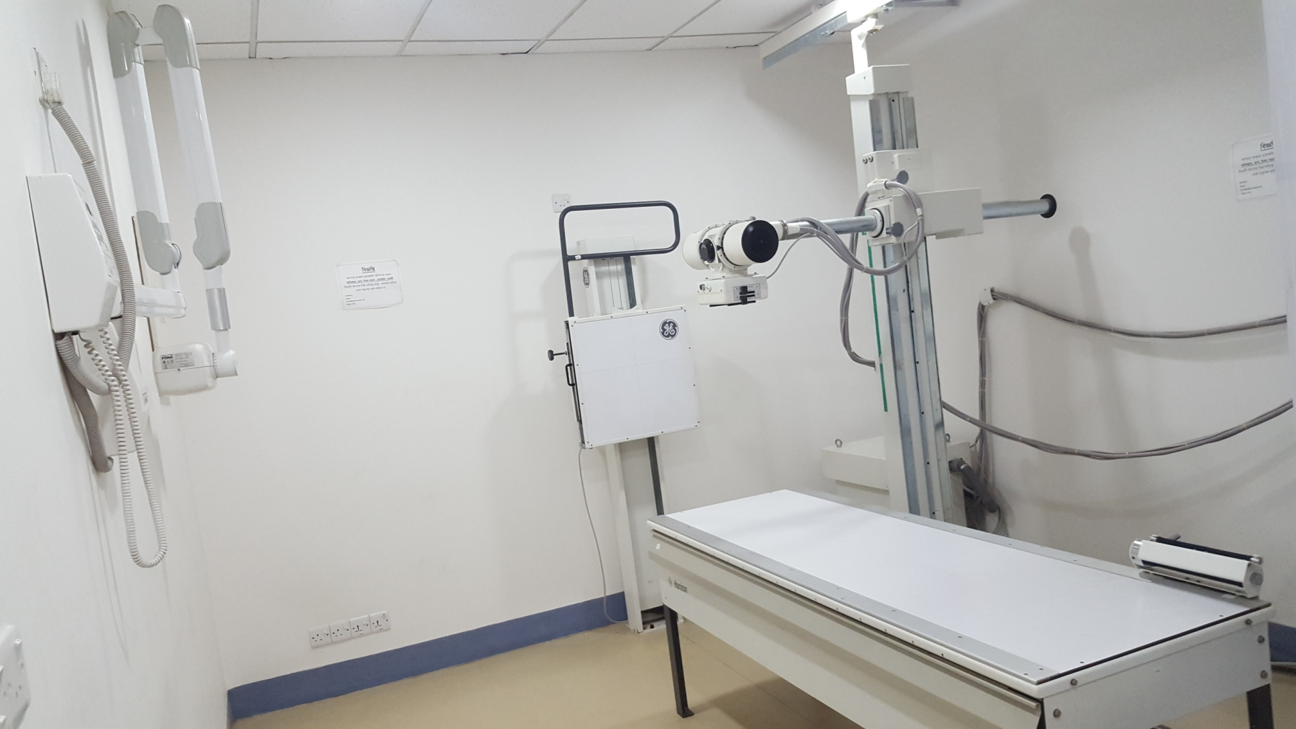
ECG
Digital X-Ray

Slide 12
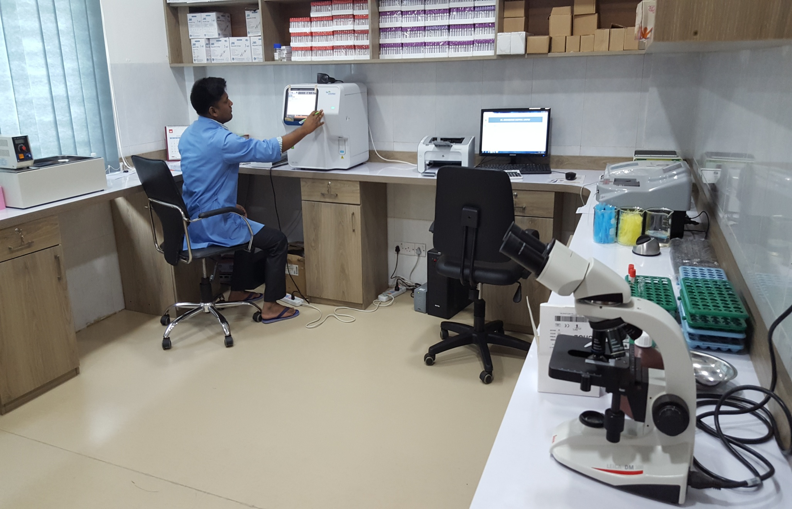
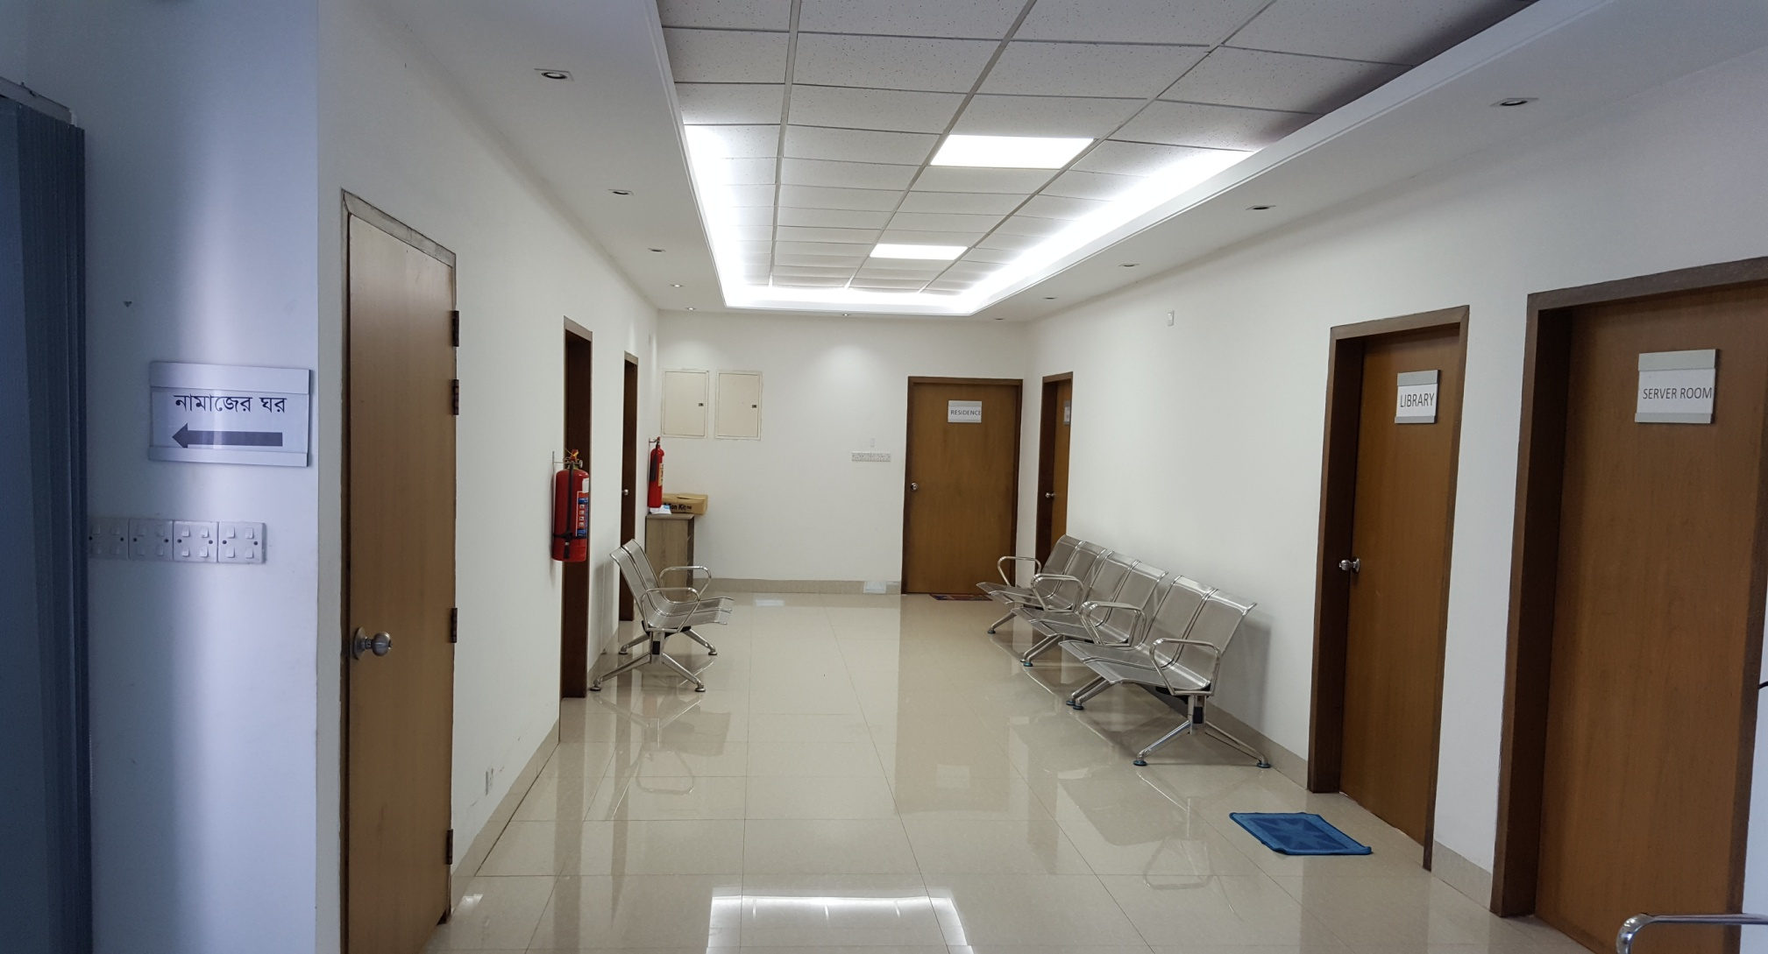
First floor: Prayer room, Server room, Library, social welfare, store & residence
Laboratory

Slide 13
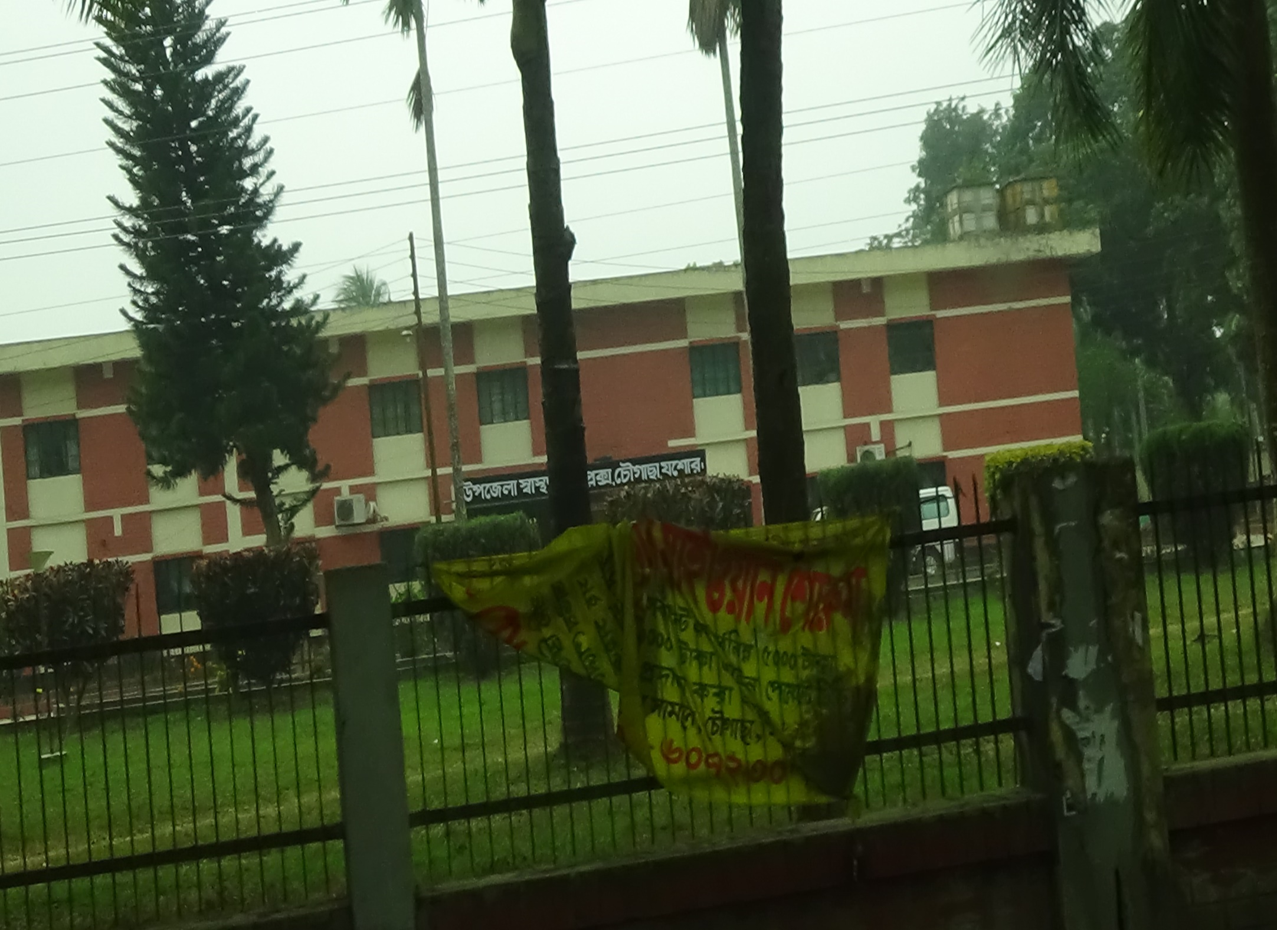
Upazilla Health Complex, Chowgacha

Slide 14
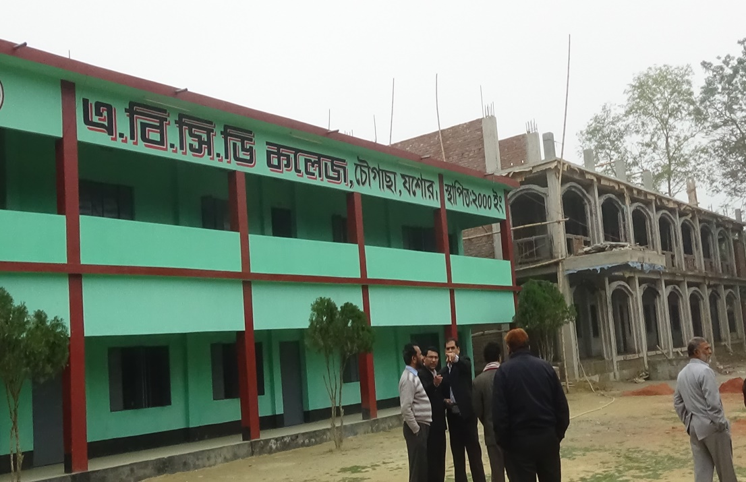
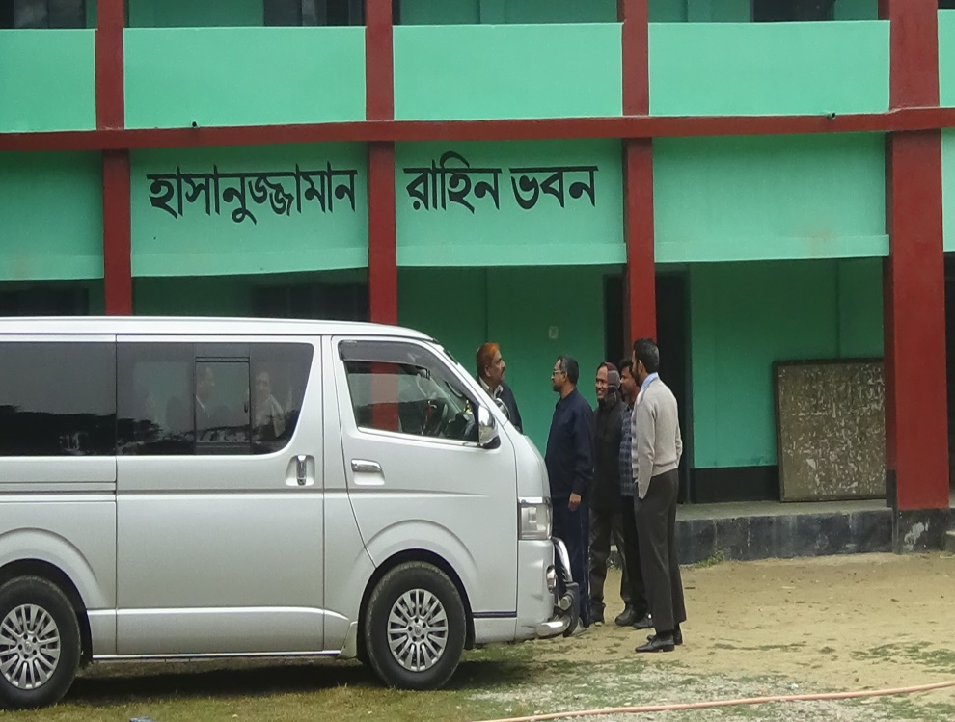
ABCD College is a Union level college having 3 Hons. Subject. The College has got a large grant from Devine Group.
Devine group supports 28 colleges, schools, madrasas and 110 primary schools for educational development

Slide 15
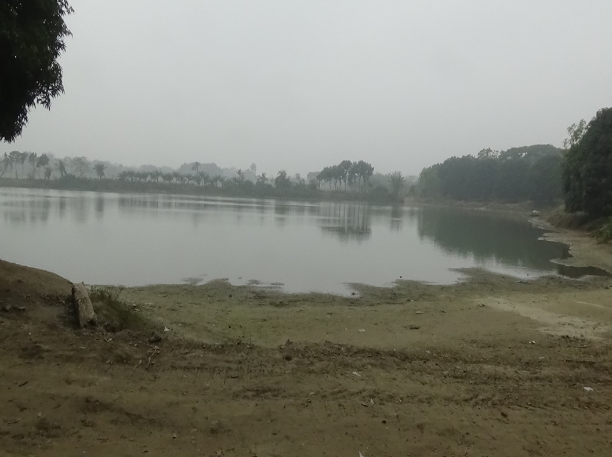
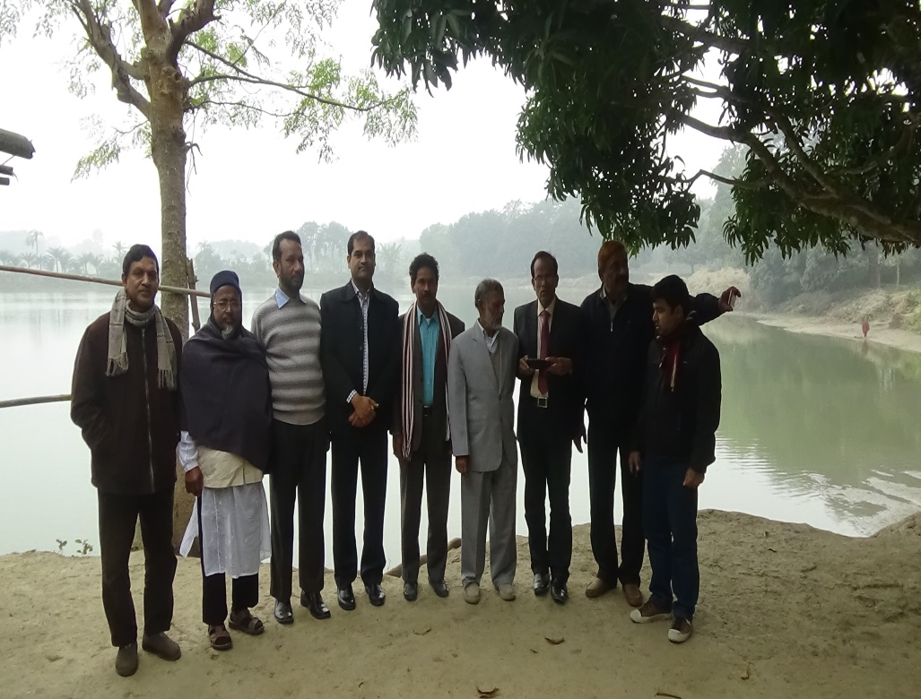
The future recreation park near Chowgacha town in a area of 10 acres.
Jhenaidah team visited the future park area.

Slide 16
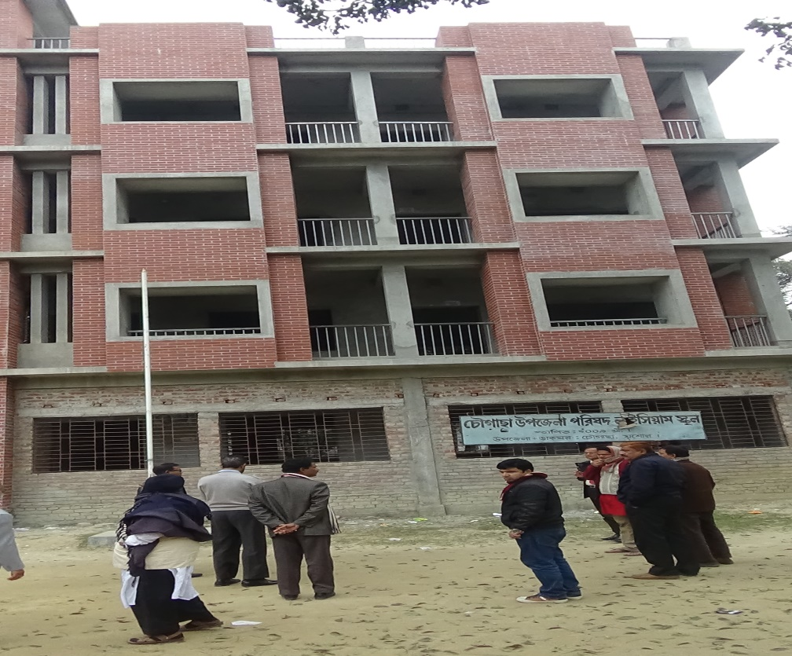
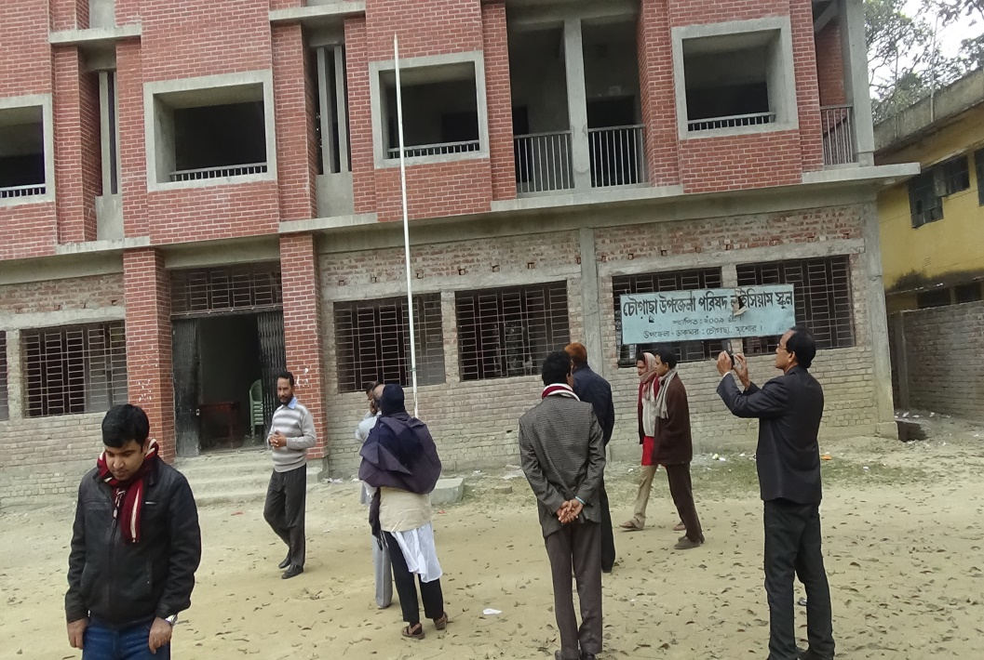
Chowgacha Upazilla Parishad Lyceum School (Primary – Class VIII) for the brilliant students of the Upazilla and for the officers’ children, supported by Devine group

Slide 17

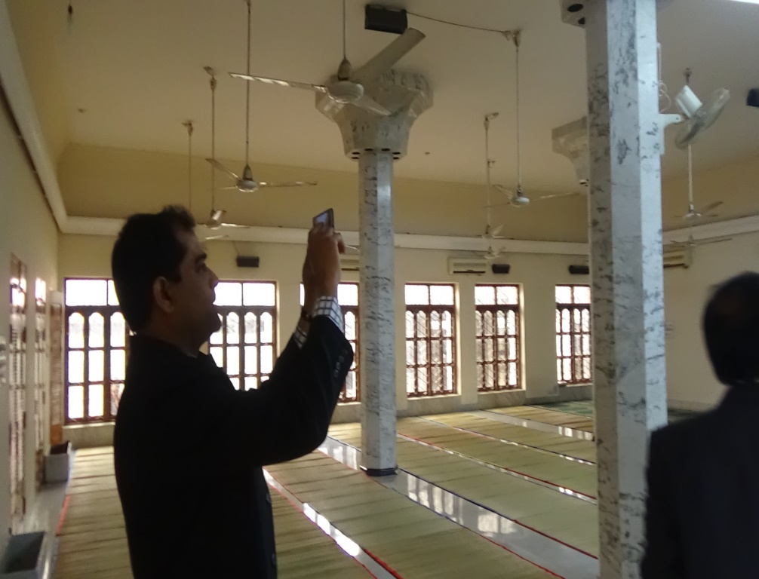
The Mosque of Devine Group
Internal View

Slide 18
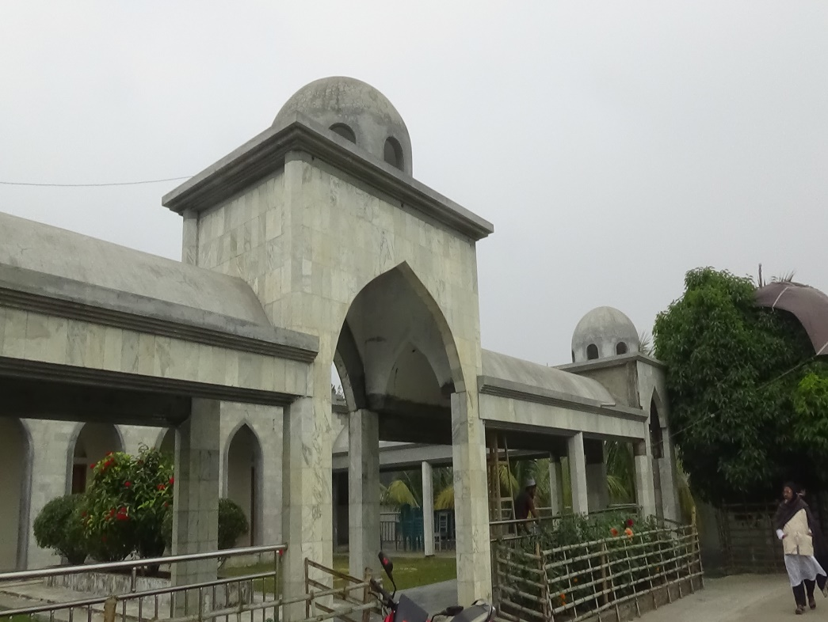
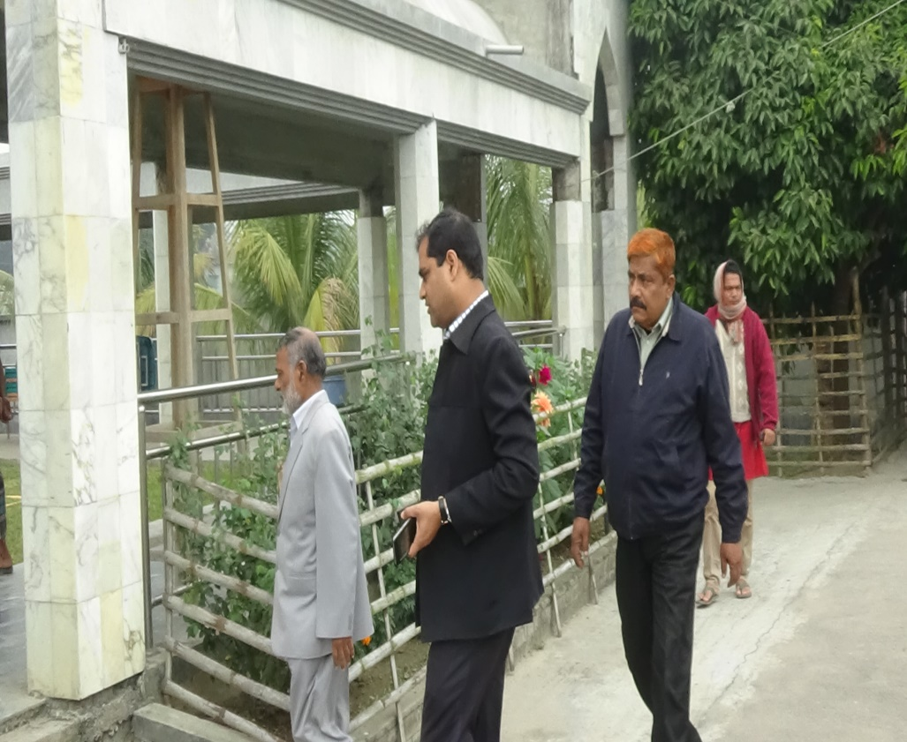
Front View
Side View

Slide 19
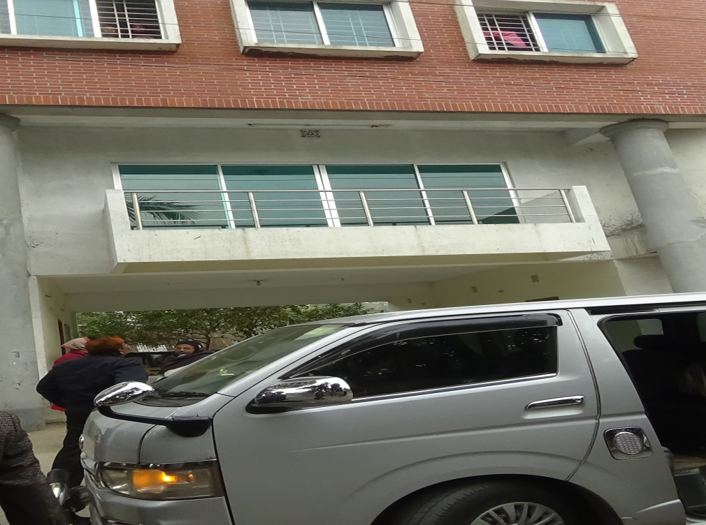
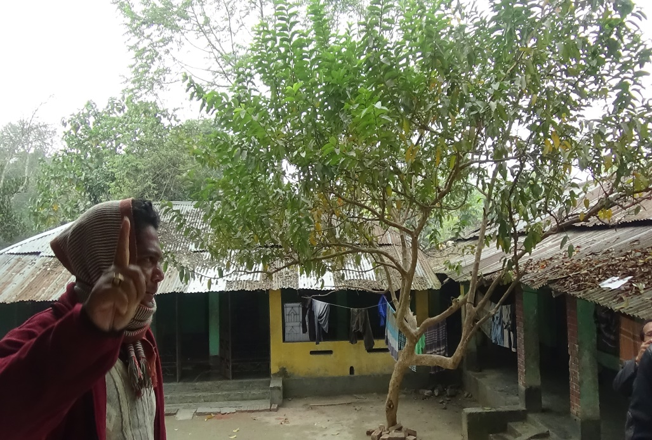
Orphanage Centre supported by Devine Group in Chowgacha.

Slide 20
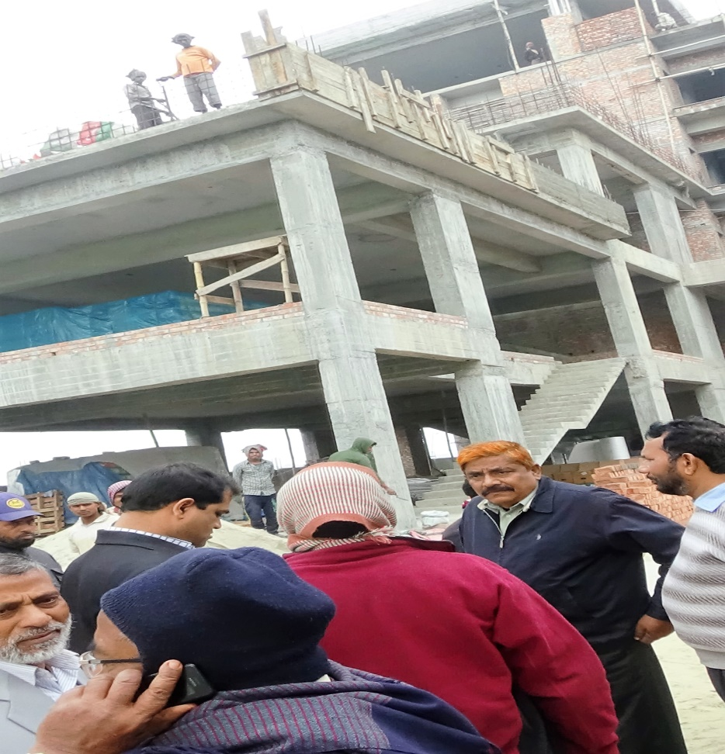
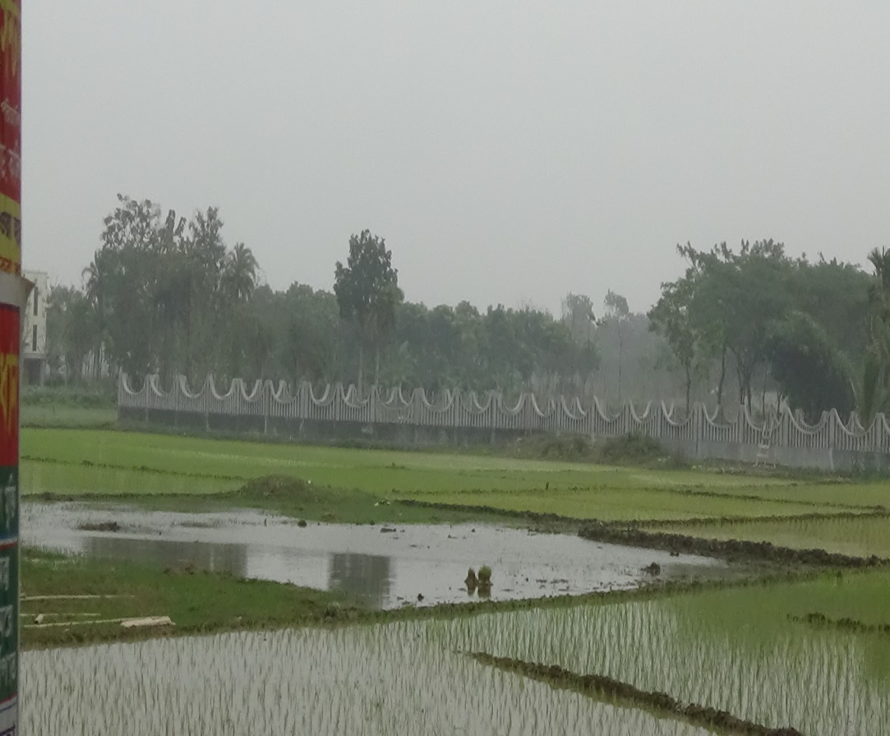
A 3 Star Hotel and Community Centre is being built by Devine Group.
A Muslim Graveyard in Chowgacha town donated by Devine Group.

Slide 21

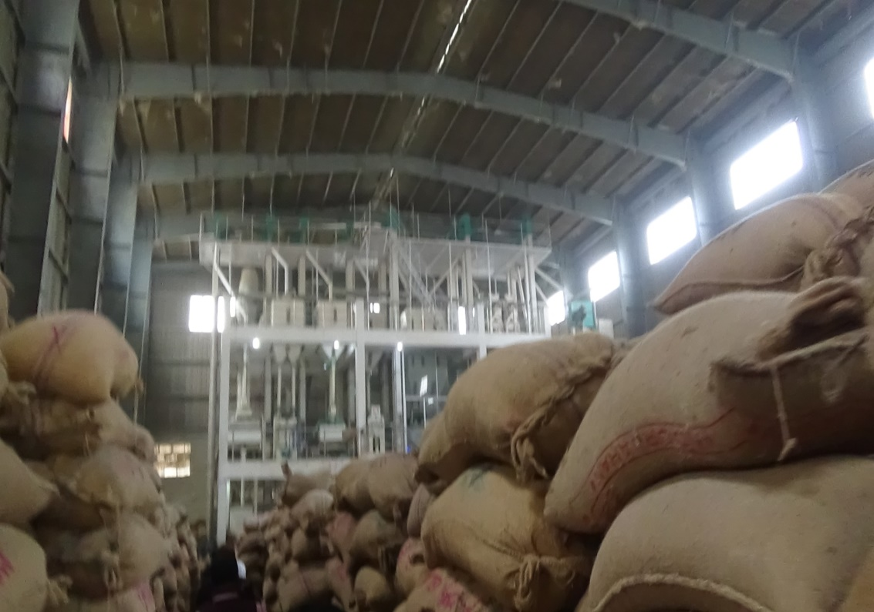
A large cold storage for Potato made by Devine group.
A rice cleaning and refine center of Devine group.

Slide 22
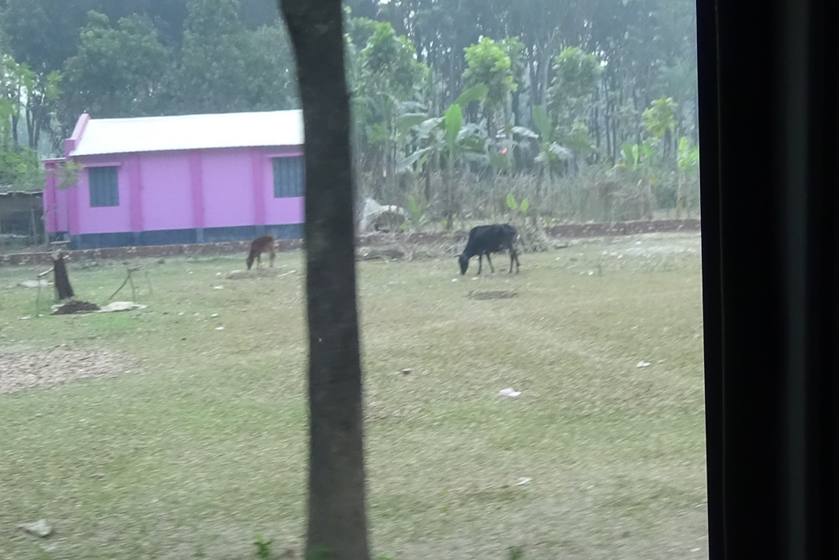
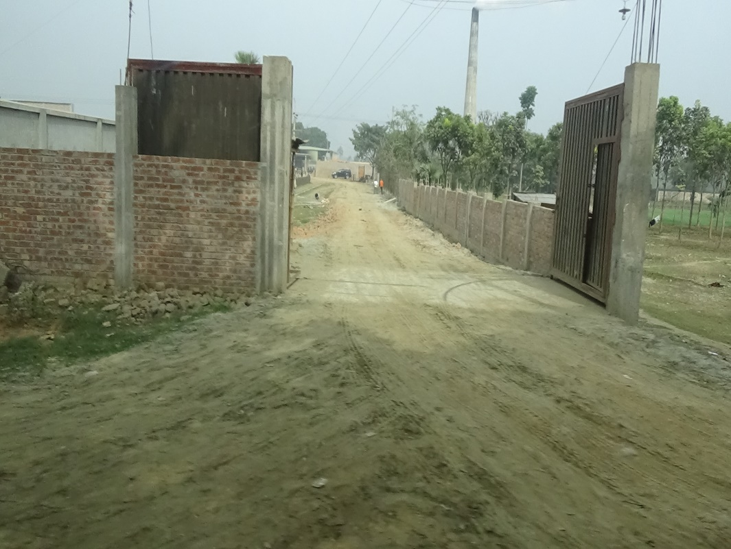
Housing service for the poor supported by Devine group. Nearly 500 house supported by the group and each costs 3 lac and 20 thousands taka.
A modern brickfield is made by the associates of Devine Group.

Slide 23
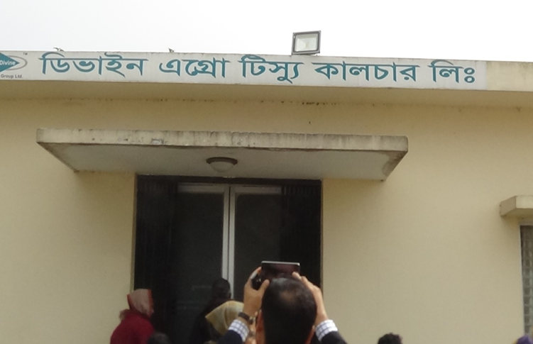
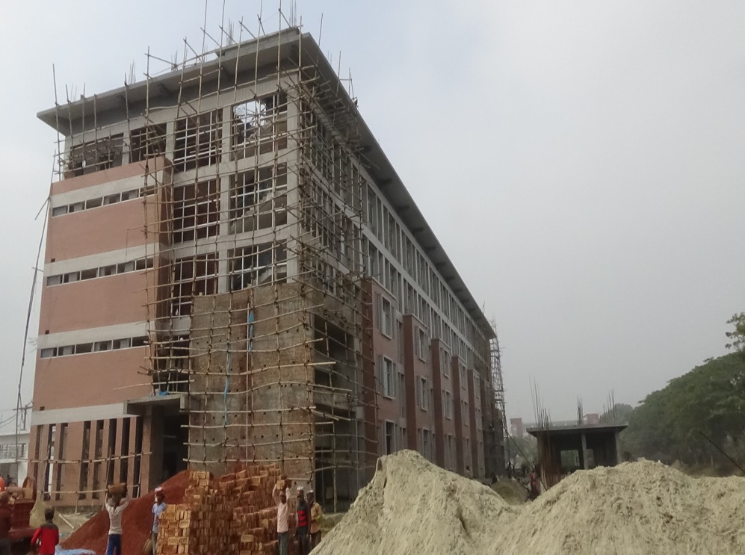
Tissue Culture Lab of Devine group.
A garments factory (exportable) is being constructed by Devine Group.

Slide 24
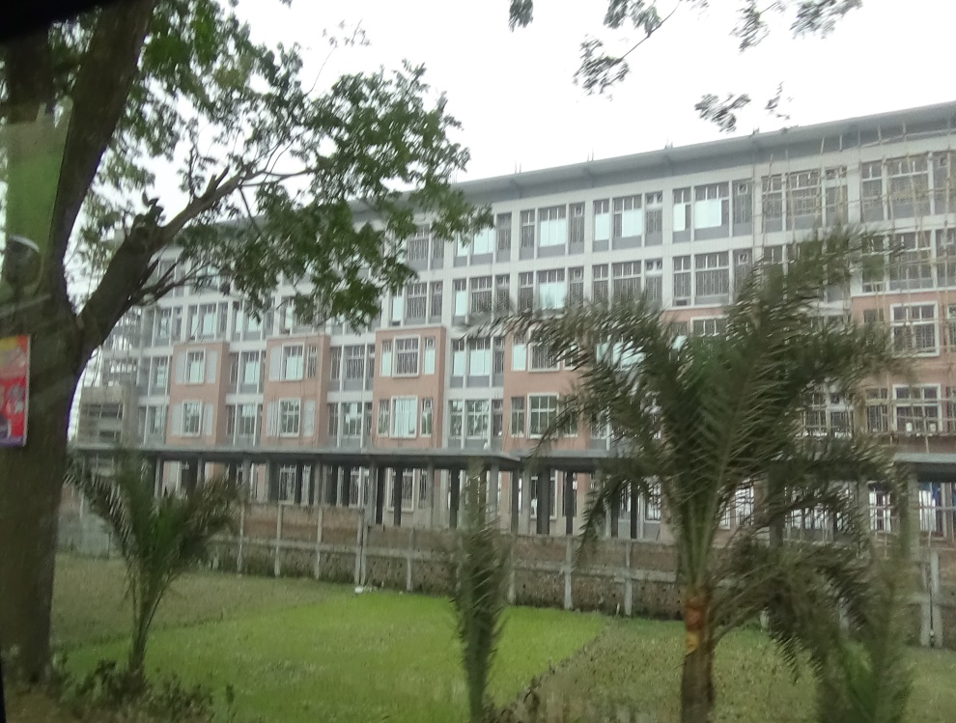
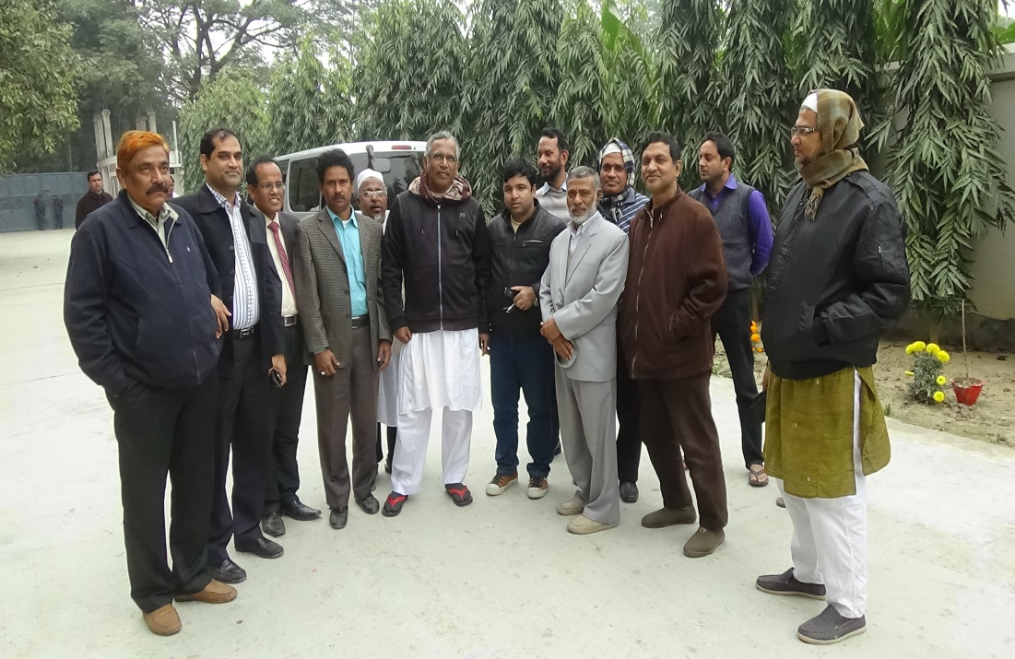
Devine Packaging LTD in Chowgacha.
Jhenaidah team with MD of Devine group

Slide 25
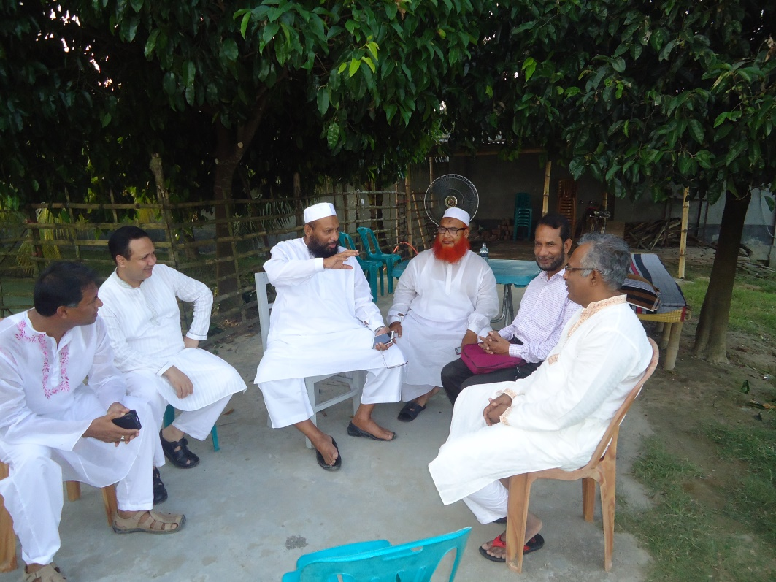
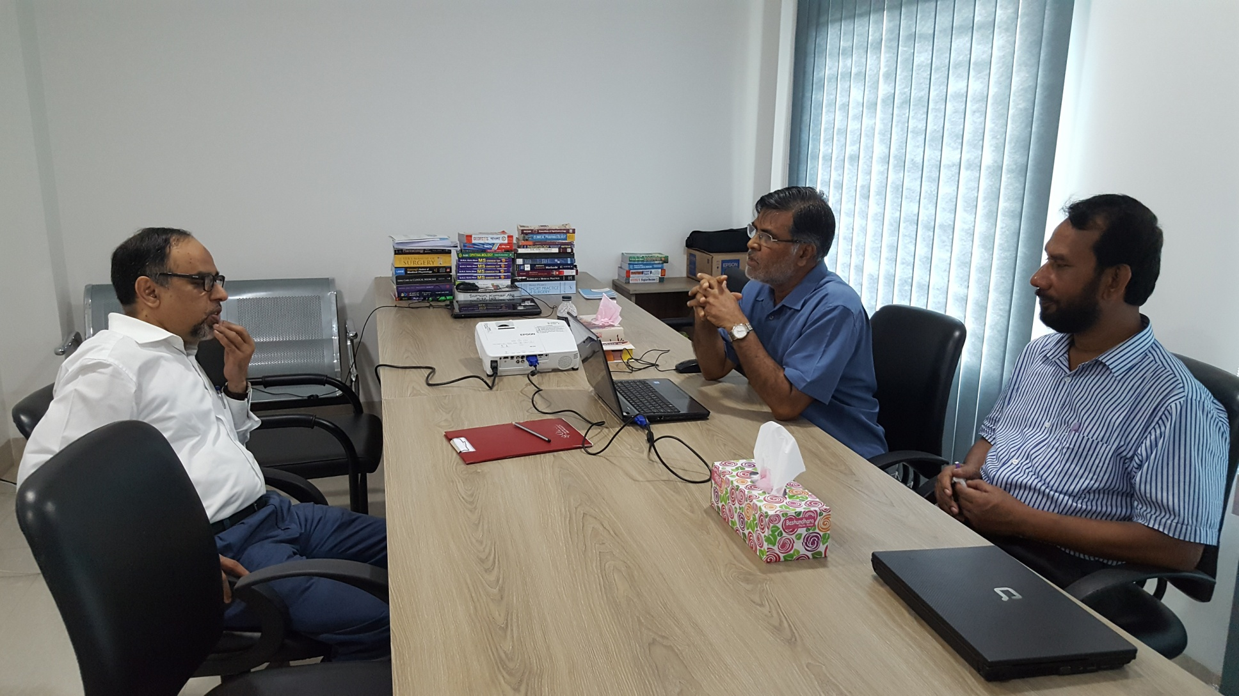
Meeting with the MD of Akiz group and Devine group who works in health and community development.
Mr. Asahadul Islam, Secretary visited Chowgacha to see the activities of Devine group.

Slide 26

Thank You

